Slide 1

Understand Average Reward
Notes:
1

Slide 2
Objectives
Describe the average reward
Understand differential value functions.
Understand Average Reward
2
Notes:
2

Slide 3
Average Reward
Example:
In most states, there's a single action available, leaving no room for decisions.
However, in one specific state, the agent can choose between two actions: traversing the left or right ring.
The reward structure entails zero rewards except for specific transitions; for instance, in the left ring, there's a +1 reward immediately after state S, while in the right ring, there's a +2 reward just before state S, implying the intuitive choice of the right action for a higher reward.
Understand Average Reward
3
Notes:
3

Slide 4
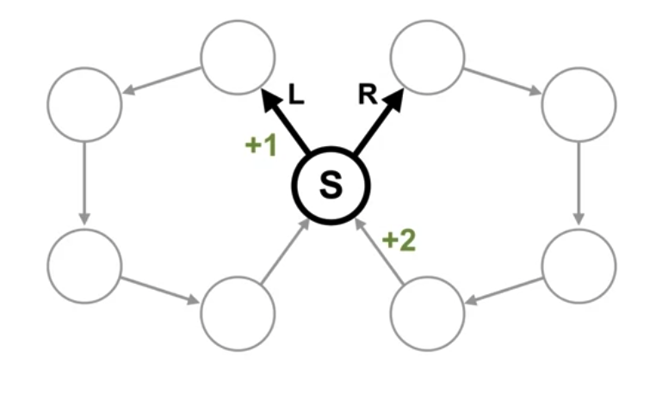
Average Reward
Example:
What would you pick? Left or Right?
Understand Average Reward
4
Notes:
4

Slide 5
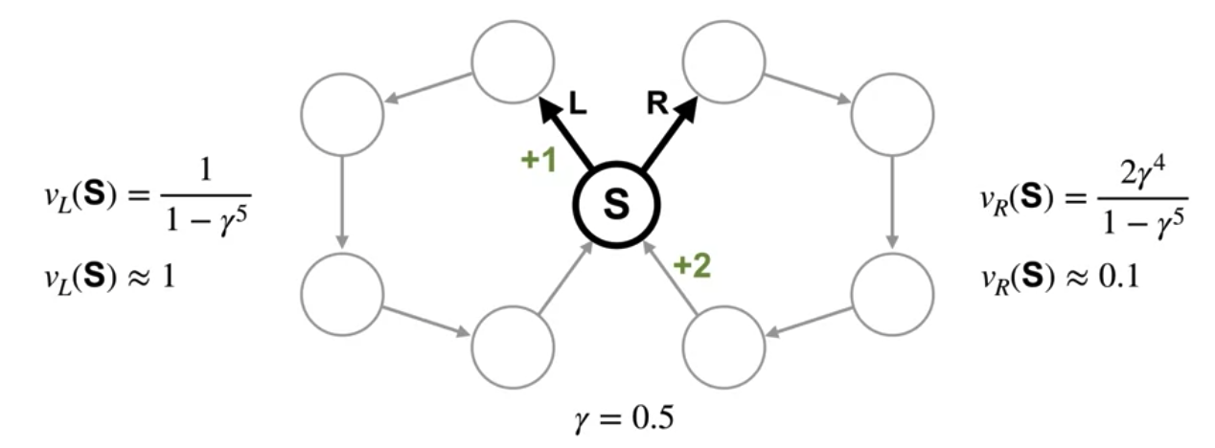
Average Reward
Example:
This means the policy that takes the left action is preferable under this more myopic discount.
Understand Average Reward
5
Notes:
5

Slide 6
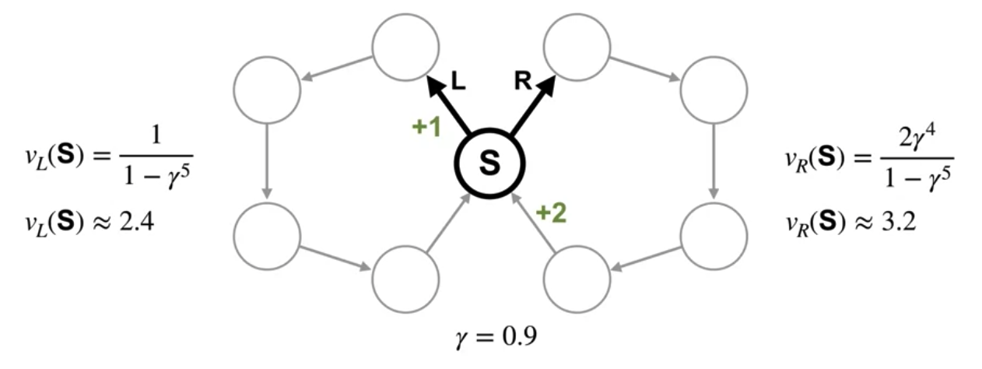
Average Reward
Example:
The agent prefers the policy that goes right
Understand Average Reward
6
Notes:
6

Slide 7
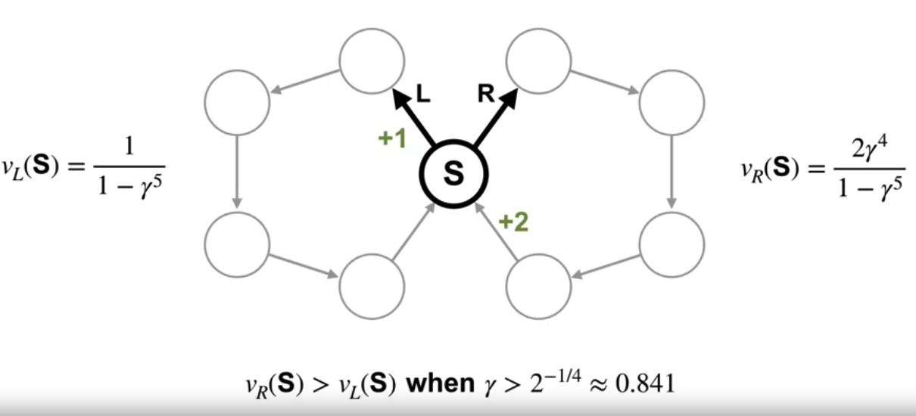
Average Reward
Example:
we can figure out the minimum value of gamma so that the agent prefers the policy that goes right. Gamma needs to be at least 0.841.
Understand Average Reward
7
Notes:
7

Slide 8
Average Reward
Example:
The only way to ensure that the agents actions maximize reward over time is to keep increasing the discount factor towards 1.
Depending on the problem, we might need gamma to be quite large.
We can't set it to 1 in a continuing setting because then the return might be infinite.
Understand Average Reward
8
Notes:
8

Slide 9
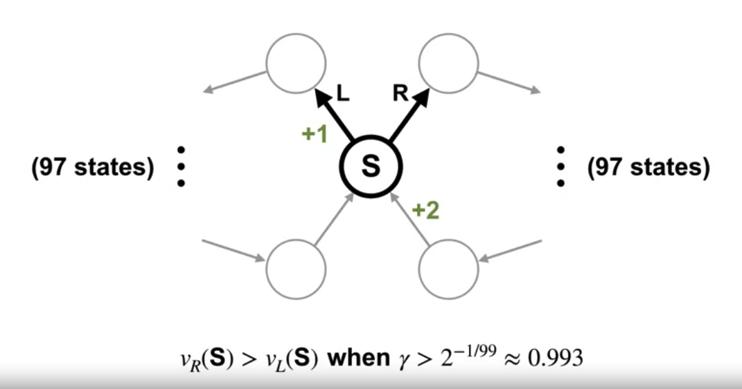
Average Reward
Example:
What's wrong with having larger gamma? -->Larger values of gamma can also result in larger and more variables sums, which might be difficult to learn.
Understand Average Reward
9
Notes:
9

Slide 10
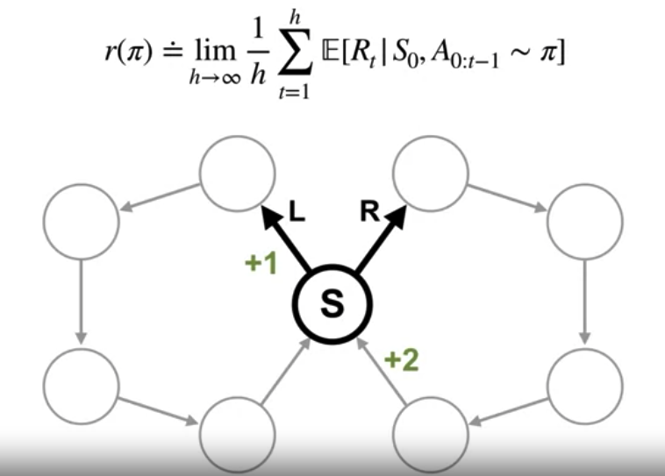
Average Reward
Example
Imagine the agent has interacted with the world for H steps.
This is the reward it has received on average across those H steps.
It's rate of reward.
Understand Average Reward
10
Notes:
10

Slide 11
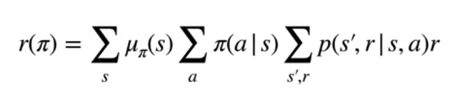
Average Reward
Example:
If the agents goal is to maximize this average reward, then it cares equally about nearby and distant rewards.
We denote the average reward of a policy with R pi.
Understand Average Reward
11
Notes:
11

Slide 12
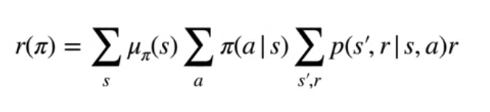
Average Reward
Example
We can write the average reward using the state visitation, mu.
This inner term is the expected reward in a state under policy pi.
The outer sum takes the expectation over how frequently the policy is in that state.
Understand Average Reward
12
Notes:
12

Slide 13
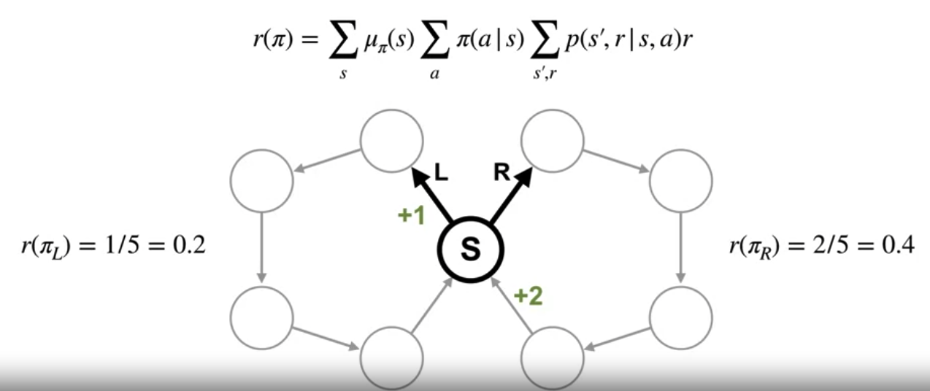
Average Reward
Example:
The average reward puts preference on the policy that receives more reward in total without having to consider larger and larger discounts.
Understand Average Reward
13
Notes:
13

Slide 14
Average Reward
Average reward is a formulation in reinforcement learning that focuses on maximizing the long-term average reward obtained by an agent interacting with an environment.
In traditional reinforcement learning formulations: the objective is to maximize the expected cumulative discounted reward over time.
Particularly those involving continuous or episodic tasks with unknown episode lengths, the average reward formulation offers advantages.
Understand Average Reward
14
Notes:
14

Slide 15
Average Reward
Objective:
In the average reward formulation, the objective is to maximize the long-term average reward per time step rather than maximizing the discounted cumulative reward.
The agent aims to find a policy that maximizes the average reward obtained over an infinite horizon or a sufficiently long time period.
Understand Average Reward
15
Notes:
15

Slide 16

Average Reward
Mathematical Formulation:
The average reward formulation is typically expressed as maximizing the following objective:
where:
T is the time horizon or the number of time steps.
Rt is the reward obtained at time step
E[⋅] denotes the expectation operator.
The objective is to find a policy that maximizes the long-term average of rewards obtained per time step.
Understand Average Reward
16
Notes:
16

Slide 17
Average Reward
Advantages:
Simplicity: simplify the analysis and computation of optimal policies
Stationarity: the assumption of stationarity is often implicit, making it suitable for environments with unknown episode lengths or varying dynamics.
Performance Metrics: clear performance metric which can be directly optimized by reinforcement learning algorithms.
Understand Average Reward
17
Notes:
17

Slide 18
Average Reward
Disadvantages:
Discounting Effects: not explicitly consider the time value of rewards or future consequences, potentially leading to suboptimal behavior in tasks where immediate rewards are prioritized over delayed rewards.
Convergence Challenges: Finding optimal policies in average reward formulations may present convergence challenges, particularly in environments with complex dynamics or non-stationarity.
Understand Average Reward
18
Notes:
18

Slide 19


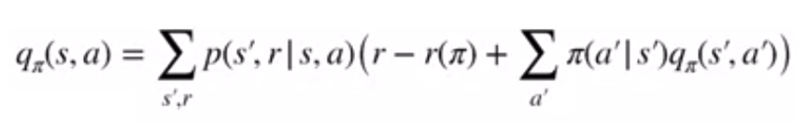
Average Reward
Value functions for Average Reward:
We define value functions, as the expected return
we define differential value functions as the expected differential return under a policy from a given state or state action pair.
Differential value functions can be written as Bellman equations..
Understand Average Reward
19
Notes:
19

Slide 20
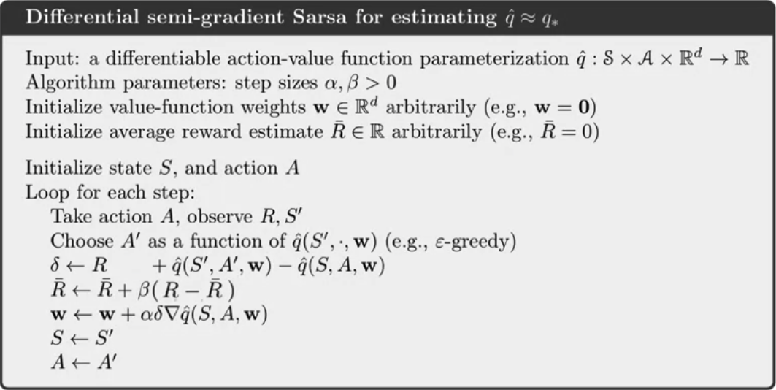
Differential Sarsa
Differential semi-gradient Sarsa for estimating q hat ~ q*:
Understand Average Reward
20
Notes:
20

Slide 21
Summary
Describe the average reward
Understand differential value functions.
Understand Average Reward
21

Slide 22
Q & A
Understand Average Reward
22

